Slide 1
ASAP Council
Al Laurita
Investigative Support Center Manager
AZ HIDTA

Slide 2
ASAP Council
2021 - Top Five Drug Threats
Southwest Border Drug Seizures
Overdose Death

Slide 3
ASAP Council
2021 Drug Threat
1 - Fentanyl
2 - Methamphetamine
3 - Cocaine
4 - Heroin
5 – Marijuana / THC

Slide 4
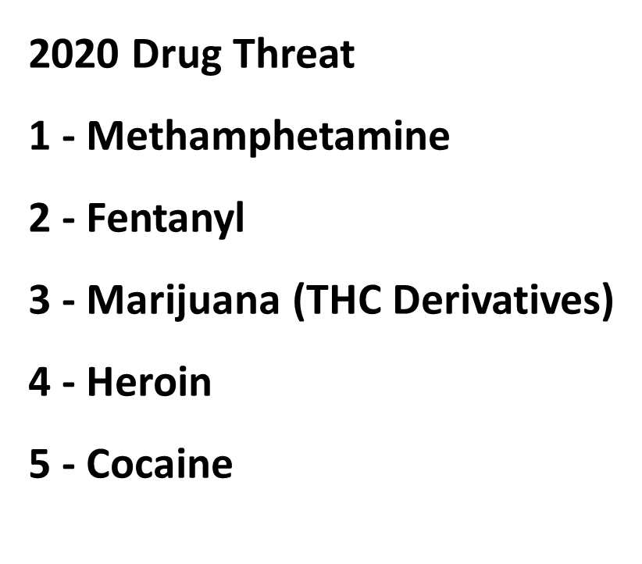
ASAP Council
2021 Drug Threat
1 - Fentanyl
2 - Methamphetamine
3 - Cocaine
4 - Heroin
5 – Marijuana (THC Derivatives)

Slide 5
ASAP Council
2021 Drug Threat Southwest Border
Texas New Mexico California Arizona Total
Fentanyl Pills 1.3% 1.9% 17% 79.5% 100%
Fentanyl Powder 10.9% 3.1% 53.3% 32.5% 100%
Methamphetamine 25.3% 1.3% 61% 12.4% 100%
Meth Solution 60% .13% 28% 11.6% 100%
Cocaine 40% 1.3% 52% 8.6% 100%
Heroin 35% 1.9% 44.5% 18.6% 100%
Marijuana / THC 20.2% 3.3% 71.3% 5.2% 100%

Slide 6
ASAP Council
Drug Overdose Deaths in the U.S. Top 100,000 Annually
For Immediate Release: November 17, 2021
Contact: CDC, National Center for Health Statistics, Office of Communication (301) 458-4800 E-mail: paoquery@cdc.gov
Provisional data from CDC’s National Center for Health Statistics indicate that there were an estimated 100,306 drug overdose deaths in the United States during 12-month period ending in April 2021, an increase of 28.5% from the 78,056 deaths during the same period the year before.
The new data documents that estimated overdose deaths from opioids increased to 75,673 in the 12-month period ending in April 2021, up from 56,064 the year before. Overdose deaths from synthetic opioids (primarily fentanyl) and psychostimulants such as methamphetamine also increased in the 12-month period ending in April 2021. Cocaine deaths also increased, as did deaths from natural and semi-synthetic opioids (such as prescription pain medication).

Slide 7
ASAP Council
American Medical Association
Issue brief: Nation’s drug-related overdose and death epidemic continues to worsen
*Updated February 15, 2022
The nation’s drug overdose epidemic continues to change and become worse. One prevailing theme is the fact that the epidemic now is driven by illicit fentanyl, fentanyl analogs, methamphetamine, and cocaine, often in combination or in adulterated forms.

Slide 8
ASAP Council
AZHIDTA Overdose Response Strategy
Shelly Mowrey
Randy Moffitt
Alexa O’Brien
Sydney Fox

Slide 9
ASAP Council
AZHIDTA Overdose Response Strategy
CNN
Middle-school children fall prey to fatal fentanyl overdoses
Fentanyl: Middle-school kids fall prey to fatal overdoses | CNN
https://www.cnn.com/2022/02/18/health/fentanyl-fatal-overdoses-middle-schoolers/index.html

Slide 10
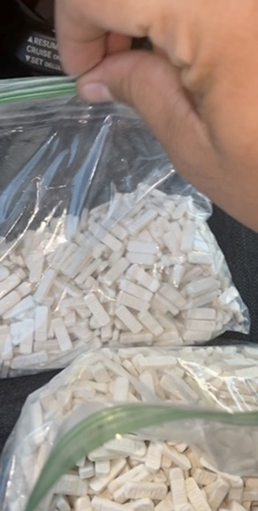
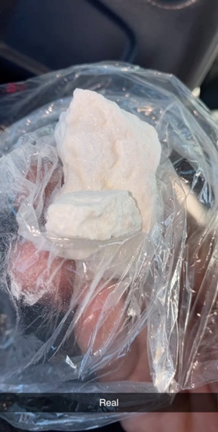
ASAP Council
Snapchat

Slide 11
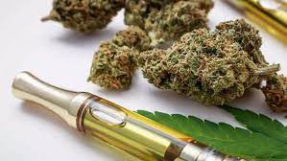
ASAP Council
Tetrahydrocannabinol (THC)
THC is the main psychoactive compound in cannabis that produces the high sensation. It can be consumed by smoking cannabis. It's also available in oils, edibles, tinctures, capsules, and more.

Slide 12
Questions?

